Slide 1
OpenGL ecosystem support in Unity
Christophe Riccio, OpenGL Maniac

Slide 2
Democratizing games development and success
Notes:
- Heart of Unity: Democratizing game development (From the very beginning)
- To paraphrase Auguste Gusteau in the Pixar movie “Ratatouille”: “Any one can make a game”

Slide 3

Monument Valley by ustwo
iOS
Puzzle game
Multidisciplinary design agency
Unity benefits:
  Ease-of-use for the whole team
  Easy cross-platform production
  Custom editor scripts
  Unity Profiler
Notes:
Because I like that game, here is an example of a game made with Unity.
It’s beautiful and for each level can amaze us with a new vision of the world
Getting rave reviews:
Monument Valley is the most elegant game I have ever played. TIM SCHAFER
Monument Valley stuns with its serenity…each screen is a work of art. HUFFINGTON POST
Almost impossibly gorgeous…a feast for your sense... 5/5. TOUCHARCADE
Link to case story: http://unity3d.com/showcase/case-stories/monument-valley

Slide 4
Video
Notes:
- Unity 5.0 graphics features video was here
- A short video of the graphics side of Unity 5.0 but there is so much more in Unity. Booth 938.
- The content of that video illustrate console, desktop, mobile and web platforms

Slide 5
Why OpenGL?
Notes:
Why Unity is investing in the OpenGL ecosystem?

Slide 6
♥
♥
♥
♥
♥
♥
♥
♥
♥
♥
Why OpenGL?
♥
♥
♥
♥
♥
♥
♥
♥
♥
♥
♥
Notes:
Why Unity is investing in the OpenGL ecosystem?

Slide 7

Unity Multiplatform deployment
Notes:
- Non exhaustive list of platforms supported by Unity
- Many different platforms. Striking with the situation 15 years ago
- Innovation can come from anywhere
- Hence, Unity is working with platform and hardware vendors to provide a smooth deployment for their platforms.
- For example, reading mailing list, 2 hours to port a game to PS4. What were these two hours made off?
- Immediate deployment is central in Unity
- To go further: We even export to Facebook.
- Now, if we look at these platforms, which one relies on Unity OpenGL back-end?

Slide 8

Platform using on the OpenGL back-end
Notes:
- Beside consoles and Microsoft Tablets and Phones, there is OpenGL everywhere.
- New actor will choose OpenGL
- Because, OpenGL is an open standard.

Slide 9
OpenGL is an ecosystem
WebGL
OpenGL ES
OpenGL desktop
Notes:
- OpenGL is an ecosystem of 3 APIs that have different roles and coexist.
- I will be show how this translate into Unity OpenGL back-end.
OpenGL => desktop => developers (You are not going to build your tools using a phone or a tablet)
OpenGL ES => mobile => users
WebGL => Web, ultimate deployment solution.

Slide 10
State of desktop OpenGL?
stats.unity3d.com
Notes:
- There has been at lot of public complains about OpenGL: This is a great news.
- It shows that more people are interested in OpenGL!
- Whether these complains are legitimated ...
- But as free citizens, we have the duty to inform ourselves correctly so it’s always nice to have our criticism stimulated.
- At Unity, we have stats.unity3d.com give visibility on platforms to our developers.
- I am responsible for the OpenGL desktop rendering back-end at Unity, let’s explore stats about OpenGL desktop.

Slide 11
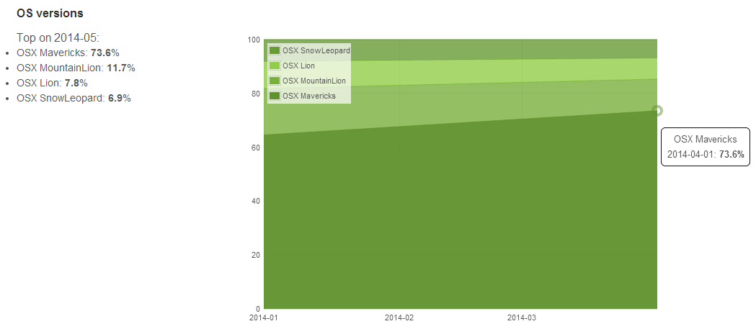
MacOSX is a OpenGL 3.2 / 4.1 platforms
The drivers are bound to the OS
Notes:
- Targetting OpenGL 3.2 makes sens.
- On MacOSX the drivers are provided by Apple with the OS revision.
- Apple is very successful at pushing the users to upgrade the OS. Making the OS free has made this migration even stronger.

Slide 12
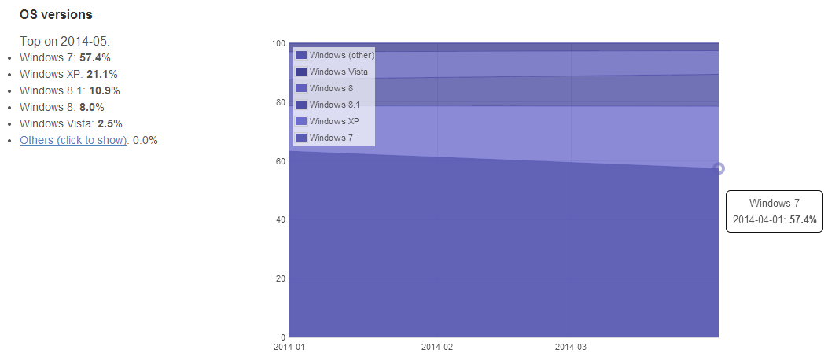
Windows is fragmented
Vista is dead but XP is getting more relevant!
Notes:
Windows Vista is dead.
Windows XP is getting more relevant essentially driven by the Asian market.
Last drivers to date:
- AMD 25th April 2014
- NVIDIA 17th Jun 2014
- Intel has dropped WinXP for Haswell (2013 GPUs)
You are not going to be able to use any cool feature with Direct3D on Windows XP!
OpenGL is awesome for developers, we get all the feature the hardware / drivers support.

Slide 13
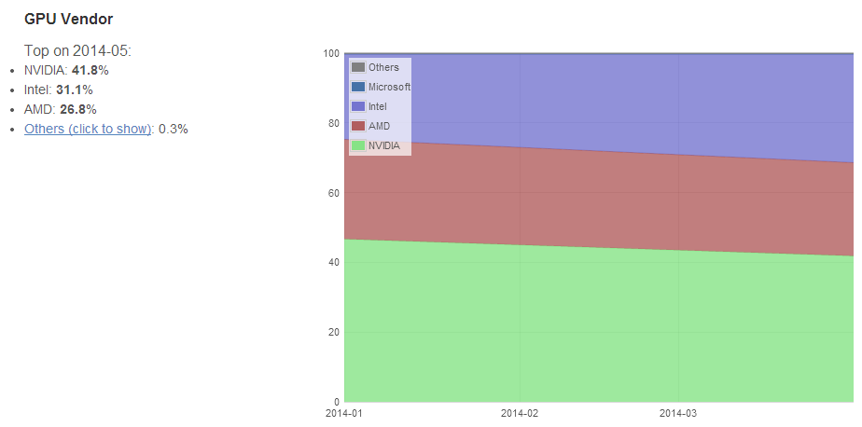
The platform market is shared
Notes:
- We need to support all vendors, even Intel
- More people are using Intel GPUs
- All vendors have driver update systems: It’s going better, not perfect
A challenge for developers is that market is well shared between vendors with Intel getting more relevant.
It doesn’t mean that Intel is particularly growing in market share, it means more people play game on Intel platforms which wasn’t possible few years ago.
All desktop vendors have drivers update systems included in their drivers package. It’s getting easier to get user to update their drivers.

Slide 14
OpenGL drivers support
www.g-truc.net
Notes:
- So far I said: « OpenGL is everywhere »
- But is it any good?
- I have a little website with OpenGL stuff
- Strange enough that only OpenGL programmers are caring about it

Slide 15
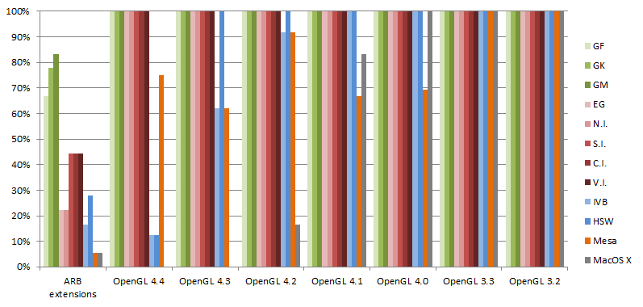
Exposed extensions to all OpenGL 4 hardware
on the last drivers available to date
Notes:
- AMD and NVIDIA exposed full support for OpenGL 4.4
- Intel exposed full support for OpenGL 4.3
- Everything detailled in an Excel spreadsheet
- There is inertia, we developers have to acknowlegde this
- People would say: « But… OpenGL is buggy! »
ARB extensions: Only list rescent ARB only extensions
OpenGL Hardware Matrix: http://www.g-truc.net/project-0034.html#menu
OpenGL 3 Hardware Matrix (legacy table): http://www.g-truc.net/doc/OpenGL%203%20Hardware%20Matrix.pdf
GF: NVIDIA Fermi
GK: NVIDIA Kepler
GM: NVIDIA Maxwell
EG: AMD Evergreen
N.I.: AMD Northern Islands
S.I.: AMD Southern Islands
C.I.: AMD Sea Islands
V.I.: AMD Volcanic Islands
IVB: Intel Ivy Bridge
Haswell: Intel Haswell

Slide 16
OpenGL drivers are getting much better, quickly!!
December 2012:
AMD expose OpenGL 4.2 support on all GPUs since Evergreen (2009)
      NVIDIA expose OpenGL 4.3 support on all GPUs since Fermi (2010)
Intel exposed OpenGL 4.0 on Ivy Bridge (2012)
Intel exposed OpenGL 3.1 support on Sandy Bridge (2011)
Apple expose OpenGL 3.2 support for everyone
Notes:
- OpenGL drivers are getting much better, quickly

Slide 17
OpenGL drivers are getting much better, fast!
July 2014:
AMD expose OpenGL 4.4 support on all GPUs since Evergreen (2009)
      NVIDIA expose OpenGL 4.4 support on all GPUs since Fermi (2010)
Intel expose OpenGL 4.3 support on Haswell (2013)
Intel expose OpenGL 4.2 support but image load store on Ivy Bridge (2012)
Intel expose OpenGL 3.1 support on Sandy Bridge (2011)
Apple expose OpenGL 4.1 support for all
Notes:
- MacOSX 10.8 dropped OpenGL 2 hardware.

Slide 18
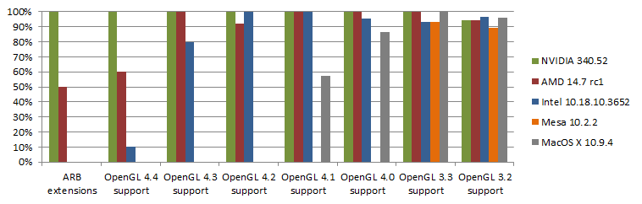
What about effective support?
Notes:
- Not an conformance report
- Just 180 samples I accumulated over time
- Everything detailled in an Excel spreadsheet
- Conclusions:
-- If you want to ship a software OpenGL 4.3 can be the upper feature level
-- On Windows, Following the past two years of drivers progress, I expect that everyone will be at OpenGL 4.5 level by next Siggraph.
-- Sadly, MacOSX is bound to 4.1 but realistically we need fallbacks.
This is not a conformance report, just the results from my experimentations on OpenGL features through about 180 code samples that I have accumulated over time.
Not everything is perfect but generally speaking, the drivers are pretty good.
Intel OpenGL driver support is great now.
We can pretty safely target OpenGL 4.3 on Windows. MacOSX remains behind in feature set.
Mesa is behind but progressing fast. This test doesn’t really reflect the feature support on Mesa as Mesa progress essentially through extensions.
OpenGL Drivers Status : http://www.g-truc.net/project-0033.html#menu

Slide 19
Conclusion:
Re-evaluation the OpenGL implementations
Notes:
it’s better than you remember.

Slide 20
Unity GfxDevice
Notes:
- Name of the class that is the renderer back-ends interface.
In Unity 5, we support only OpenGL 2.1 but we are working hard on a modern OpenGL back-end because structural changes happened in the environment:
WebGL
Better ES but that only good for the users
Better GL, because at the end of the day, I never saw any developer working on phones or tablets to build a game

Slide 21
OpenGL convergence
Extensions:
- GL_ARB_ES2_compatibility
- GL_ARB_ES3_compatibility
- GL_ARB_ES3_1_compatibility
ES profile on desktop
- WGL/GLX_EXT_create_context_es_profile
EGL on desktop
- This is the ultimate goal but the ecosystem is still W.I.P.
- Software Emulators
There is at least one solution is available on each platform
Notes:
- For OpenGL support on desktop in 5+ we will relying on OpenGL convergence
- Convergence is a Khronos initiative launched few years ago to guarantee that OpenGL and OpenGL ES doesn’t diverge
- OpenGL ES hence remains a strict subset of OpenGL.

Slide 22
OpenGL convergence
A mix of feature levels and capabilities flags
Feature levels, essentially driven by our shader pipeline:
OpenGL ES 2.0 / WebGL
OpenGL ES 3.0 / OpenGL 3.2
OpenGL ES 3.1 / OpenGL 4.3 or OpenGL 4.2 + compute shader stuff
“Player” base level: ES 2.0 / “Editor” base level: GL 3.2
The “subtleties” between the level: Handled by capabilities.
Notes:
- Some people will say that you should have a different back-end for OpenGL and OpenGL ES
- Or experience is that it will lead to unnecessary back-end divergences and duplicated work

Slide 23
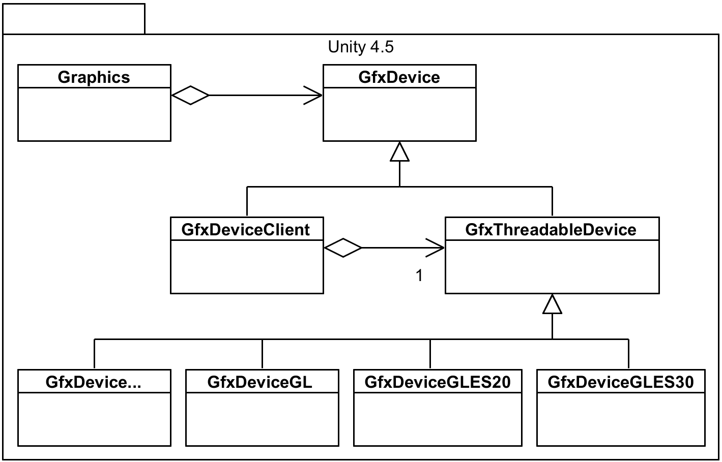
Unity 4.5 renderer design overview

Slide 24
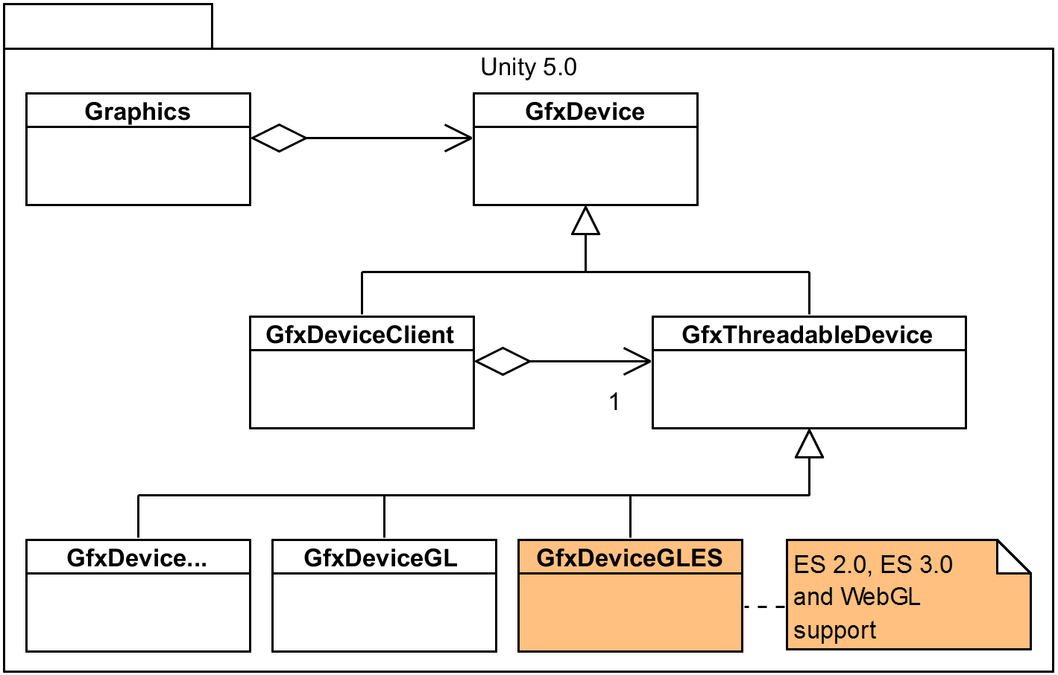
Unity 5.0 renderer design overview
Notes:
- OpenGL is not a first class citizen still in Unity 5.0
- Who need to use -force-opengl argument. Default is D3D11.

Slide 25
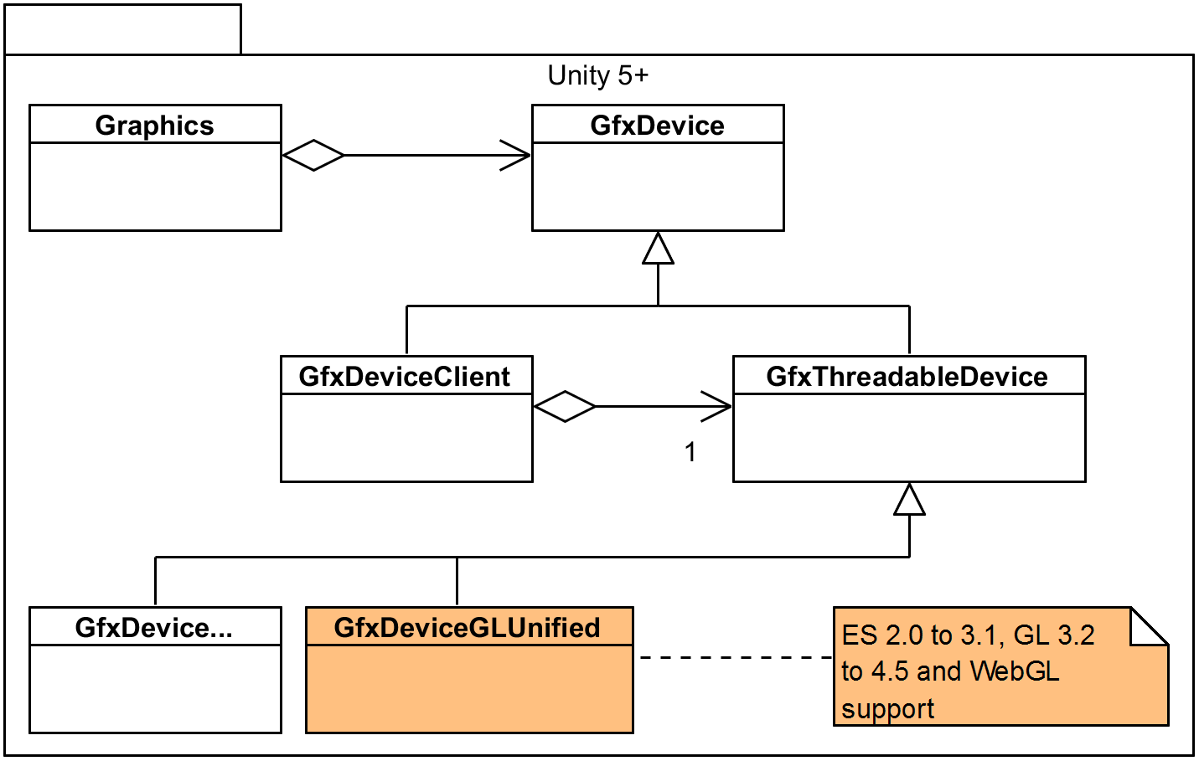
Unity 5+ renderer design overview
Notes:
- But we are working on making OpenGL a first class citizen.
- Thanks to the “OpenGL” convergence.

Slide 26
Resolve difference between OpenGL versions
It can be essentially resolve at initialization time or compilation time
Capabilities: Initialized at initialization time
Translation tables: from engine enums to appropriate OpenGL enums
#ifdef to remove code on platform that can’t possibly run something

Slide 27
Working around drivers bugs
Part of the capability flags: Disable the capability if it is buggy
- Micro managing bugs doesn’t scale
  Fallback to lower feature level
  - If GL4 feature level doesn’t work, use GL3. If GL3 doesn’t work use GL2
Have shader fallbacks
- We are going as far as showing a pink shaders
Document the bug workarounds: Platform, vendor, what’s wrong
- They will be a point where no body remember why this ugly workaround is here
- They will be a point where that workaround should be removed because not useful anymore

Slide 28
“Pro tips”
Working on desktop OpenGL?
- Have AMD, Intel and NVIDIA GPUs in your dev machine all the time
- Plug a screen per GPU
- Change main display to select a different GPU
  Starts from OpenGL ES to OpenGL desktop
  - Convergence is ensured by desktop the OpenGL specifications
  - Use a single OpenGL back-end to avoid divergence
Document drivers bugs and workaround in your code
- Otherwise we won’t know when we could discard workaround!
Have an automated graphics tests farm
Use (or implement!) KHR_debug
Thread the OpenGL back-end

Slide 29
The next ecosystem
Notes:
Sadly, marketing people at Khronos doesn’t allow us to say much.

Slide 30
♫
♪
♫
♪
♪
♫
♫
♫
♪
♪
♪
♪
♫
♫
♫
The next ecosystem
♪
♫
♫
♪
♪
♫
♪
♫
♫
♪
♪
♫
♫
“♫ Everything is awesome ♪” The Lego Movie, 2014
♫
♫
♪
♫
♪
♪
Notes:
“Everything is awesome”
“Everything is cool when you are part of the team”
“Everything is awesome, when we are living our dream”

Slide 31

Unity in numbers:
600,000 + monthly active users
750,000 + registered Asset Store users
Close to 3 million registered developers
Real time graphics is not a matter of a few millions people anymore
A potential target is billions of people
Notes:
- A lot of people develop with Unity
- Real time graphics is not just about games it concerns everyday life

Slide 32
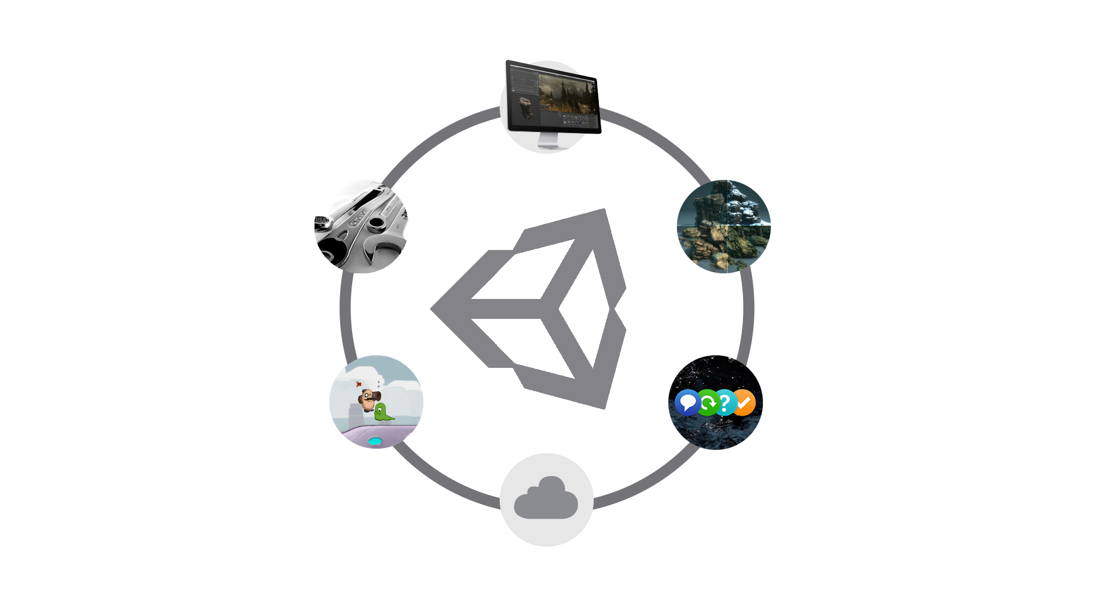
Engine
Support
Asset Store
Learn
The Community
Cloud services
Notes:
- Unity is about 500 employees but these days making an engine is really not just about making an engine.
- No, we don’t have 100 people doing just graphics!
- A third of us is doing R&D
- The engine ecosystem is becoming more and more important to make Unity developers successful.
- We need an API ecosystem strong enough to scale and focus on features instead of making things working.
The Engine for developing and deploying any kind of 2D and 3D interactive content.
The Asset Store: online marketplace for Unity developers to sell and buy or download for free ready-made assets and production tools. Currently over 15,000 products on the shelves
Unity Services: upcoming tools integrated into the engine for marketing, analytics and player retention, as well as cloud-hosted multiplayer support, build testing and deployment
The Community: user forums, local user groups, Unity’s own annual developer conference, Unite.
The Education… : ever-growing program of free video tutorials, complete downloadable projects and live online training. Provided by our in-house education team.
…and Support: From free for anyone online support to tailored, on-site consultancy.

Slide 33
The next ecosystem
The environment has changed:
- More and more platforms!
- It is often not enough to support a single platform
- Virtual Reality is credible
800 pages for OpenGL 4.5 core spec, 478 pages for OpenGL ES 3.1 spec:
- Too complex for developers and hardware vendors
- And effectively we need to work over multiple specification versions!
Long-standing OpenGL design issues:
- Threading
- Shader compilation pipeline
- Lack of control of what the drivers does
- Hidden validations and allocations in the rendering loop
- Handling driver issues is done per vendor not for everyone
- OpenGL is a hack on tile based GPUs
Notes:
Join to know more.

Slide 34
Solving issues globally
(Instead of individually)
Dealing with issues individually (current OpenGL ecosystem):
- Per-vendor
- Other programmers will hit the same issues
- N => 1 relation
Dealing with issues globally:
- A programmer reports one issue, it propagates to all programmers and vendors
- 1 => N relation
Example of globally solving issues: WebGL conformance test
- Open sourced
- Users can submit tests
- WebGL platforms are reliable! (We don’t have per platform wordaround flags!)
Notes:
- The OpenGL ecosystem needs to be more efficient to resolve issues.

Slide 35
Intermediate Shading Language
With current GLSL:
- 4 ES versions !
- 8 core profile versions !!
- 12 compatibility profile versions !!!
Issue 1: GLSL couples syntax sugar and hardware features
Issue 2: Vendors don’t fix some issues to avoid breaking current software
How do we deal with this in our shader compilation pipeline?
Notes:
- There are so many different GLSL language flavours that it’s impossible to support them all
- Shaders need to be generated offline

Slide 36
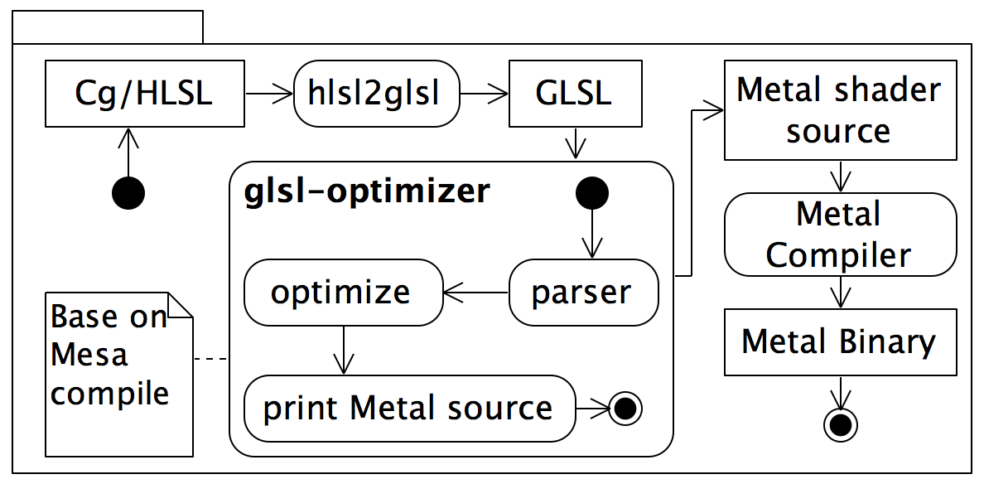
Example of a current shader pipeline
Notes:
Metal might be a great API but it’s not solving our shader pipeline complexity issue

Slide 37
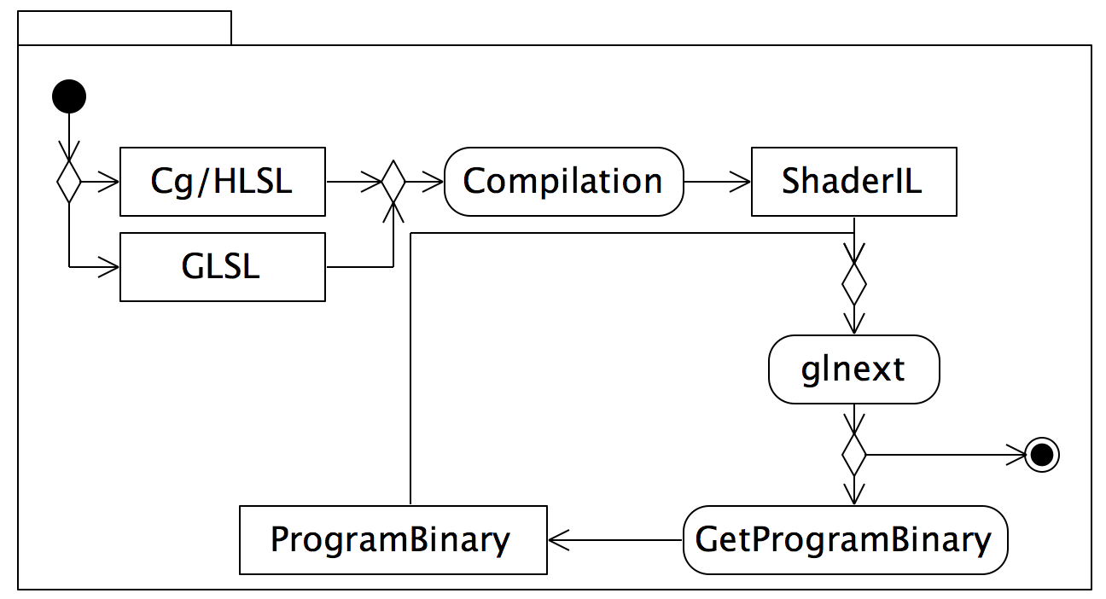
Wish shader pipeline
Notes:
- Cg/HLSL, GLSL should generate Shader Intermediate language

Slide 38
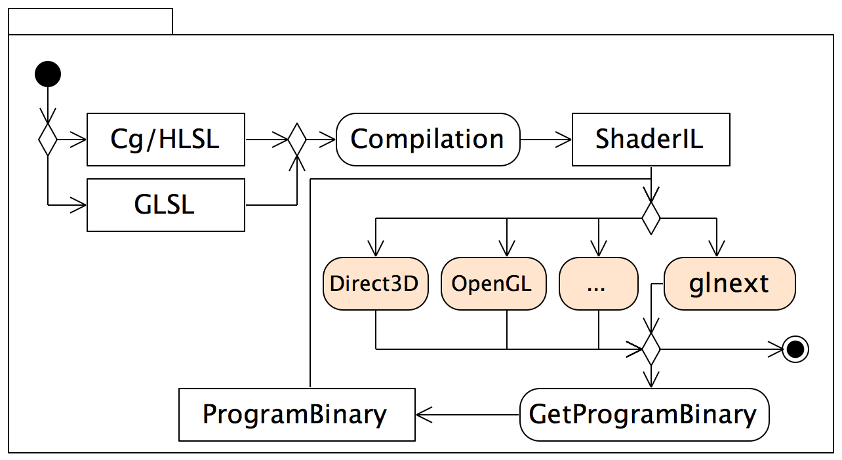
Bigger wish shader pipeline
Notes:
- Why not getting this support on others APIs? Metal, Direct3D, libgnm.

Slide 39
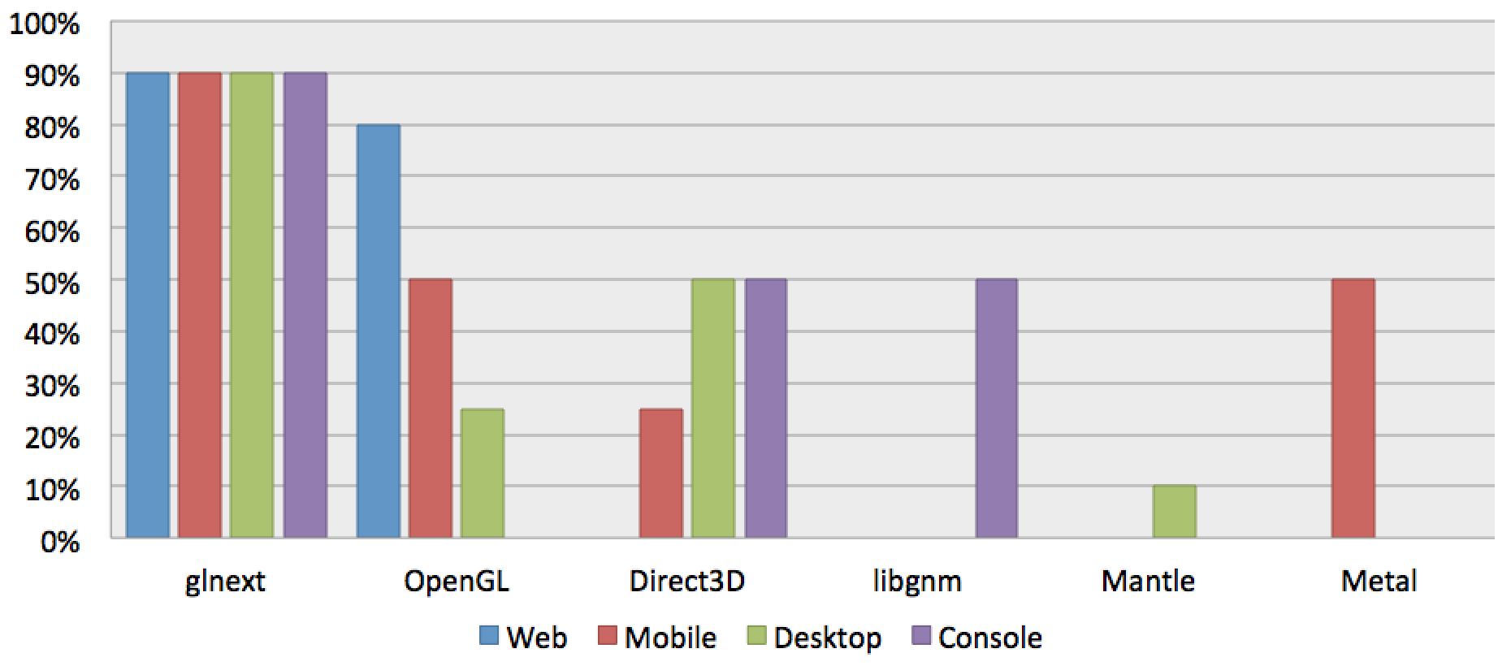
"Relevance" of ecosystems per platform
Notes:
- Let’s be bold!
- “Relevance” is just a personal opinion.
- Relevance is a mix of Performance, Reliability, Market size and “does it pay the bills”.
- I added console, not that I think it’s going to be supported on current consoles, but for next gen consoles it’s certainly something that vendors should consider.
- 90% only because nothing is ever perfect.
- Obviously, it will depends on adoptions.

Slide 40
Special thanks to:
Engine representatives at Khronos:
- Timothy Lottes (Epic)
- John McDonald (Valve)
- Patrick Doane (Blizzard)
- Johan Andersson (Frostbite)
Aras Pranckevičius (Graphics Plumber at Unity)
- “Ship it!”
The OpenGL community
- Ask your hardware vendors and platform vendors for roadmaps, show your interest!
Notes:
We are going to make it happening!

Slide 41
Join and contribute!

Slide 42
Extra slides
Notes:
We are going to make it happening!

Slide 43
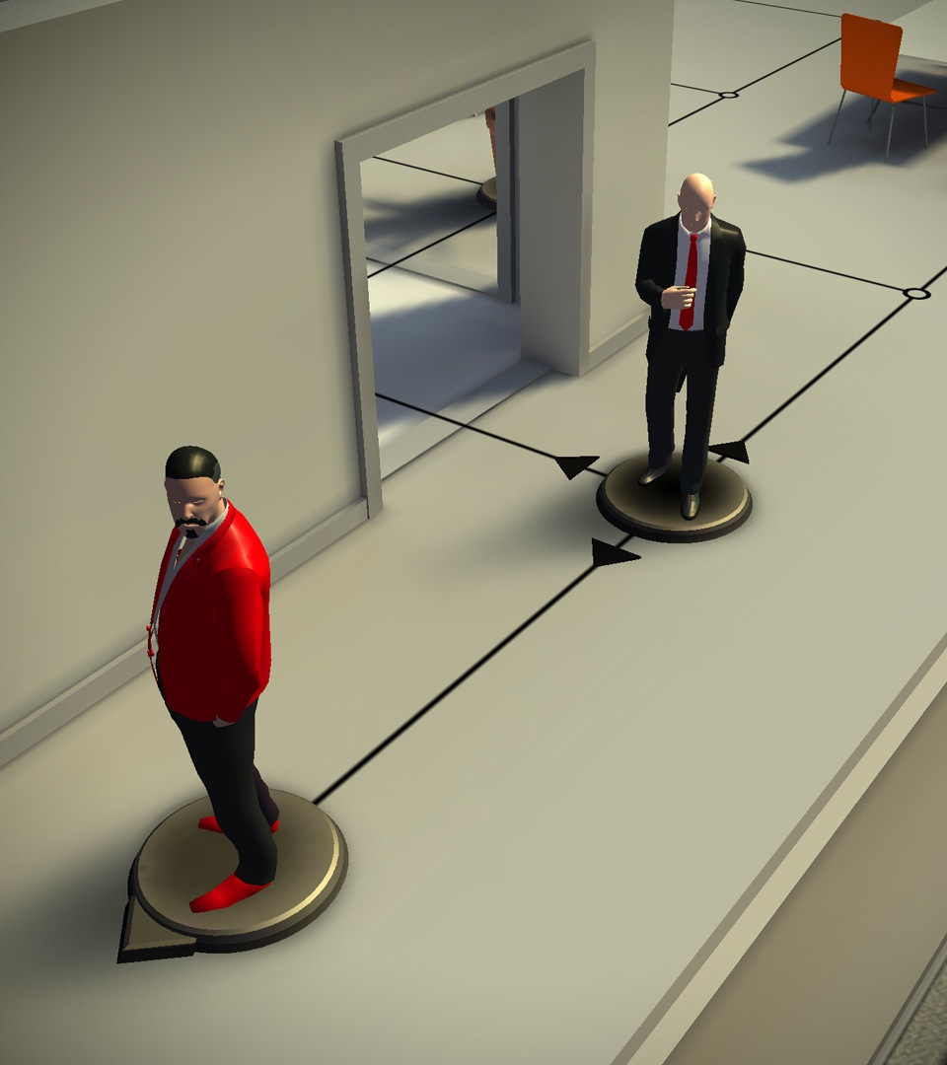
Hitman GO
by Square Enix
iOS
Puzzle game
Developed by
Square Enix Montreal
Unity benefits:
  Mobile support
  Rapid production
  Visual quality
Notes:
Latest example from Hitman series
Debuted as one of top 10 paid apps in App Store
Unique high quality visuals
Great example of taking a console title and transforming it into a mobile game
Overall good reviews

Slide 44

Deus Ex
by N-Fusion/Eidos Montreal
iOS, Android
Action, RPG
Unity benefits:
  Cost effective
  Rapid production, ease of use
  Asset Store
Notes:
Costs kept down, teamsize kept relatively small due to Unity ease of use
Tools were a huge time saver
Asset Store: ‘enormous impact on production of game’-
Link to case story: http://unity3d.com/showcase/case-stories/nfusion-eidosmontreal-deusex-thefall

Slide 45
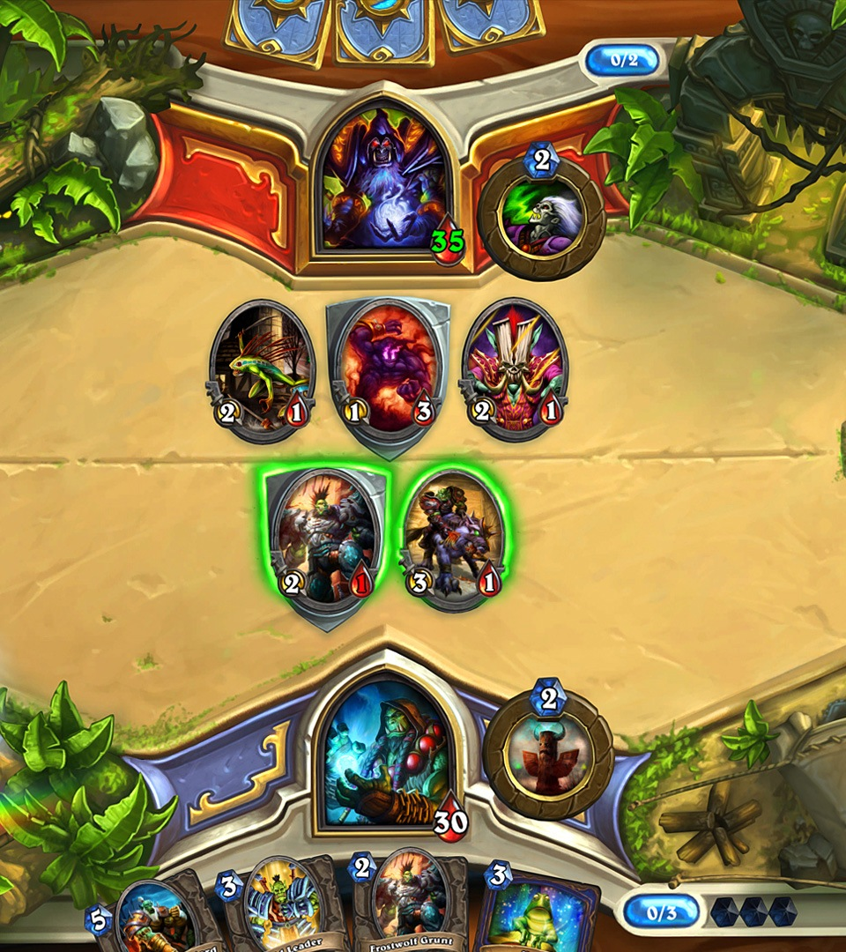
Hearthstone
by Blizzard
PC, Mac, iPad
FTP strategy card game
Unity benefits:
  Rapid iteration
  Flexibility
  Multiplatform, multiplayer support
Notes:
More than ten million registered players less than a month after its official PC debut (source: Gamasutra)

Slide 46

Bad Piggies
by Rovio
Android, Blackberry, iOS,
Mac & Windows
Unity benefits:
  Rapid production
  Fosters innovation
  Multiplatform support
  Asset Store
Notes:
Unity workflows contributed to evolution of gameplay
Example of well-established, highly successful studio that gained huge benefits from using Unity
Asset Store cut production time
link to case story: http://unity3d.com/showcase/case-stories/rovio-badpiggies

Slide 47
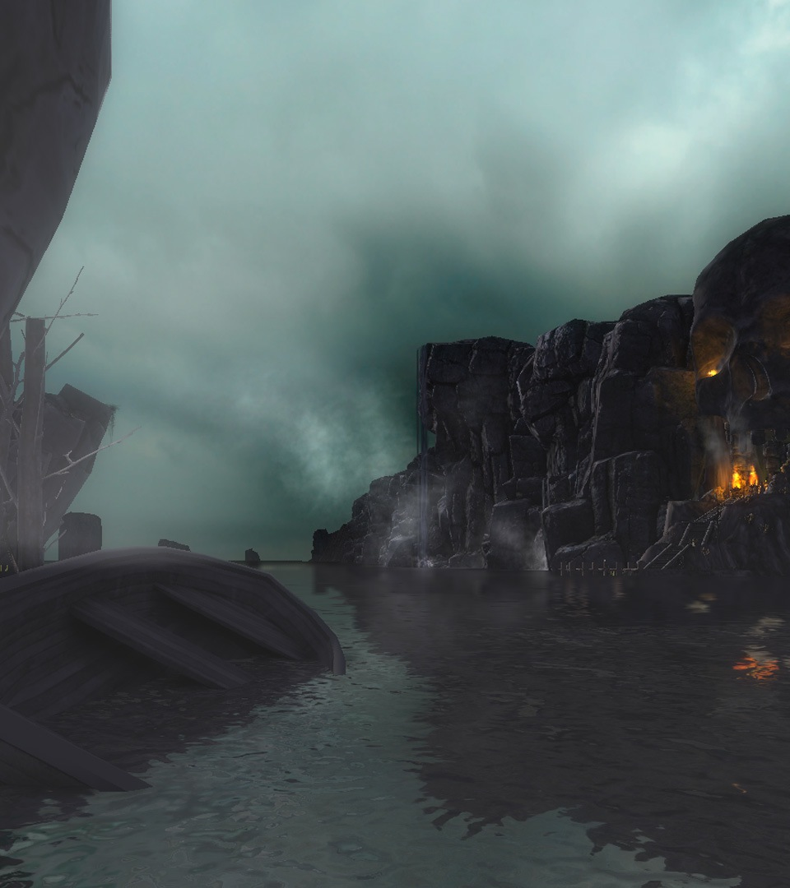
Shroud of the Avatar: Forsaken Virtues
by Portalarium
Linux, Mac & Windows
MMO in production: full-scale
RPG with multiplayer and world persistence
Studio headed by Richard Garriott
Unity benefits:
  Speed of production
  Visual, performance quality
  Community
  Asset Store
Notes:
Garriott is creator of iconic Ultima series
From Garriott: ‘Unity is saving us years of development and millions in costs.’
Asset Store: ‘saving countless man months on both programming and content production
went from nothing to proof of concept in a month
link to case story: http://unity3d.com/showcase/case-stories/shroud-of-the-avatar

Slide 48
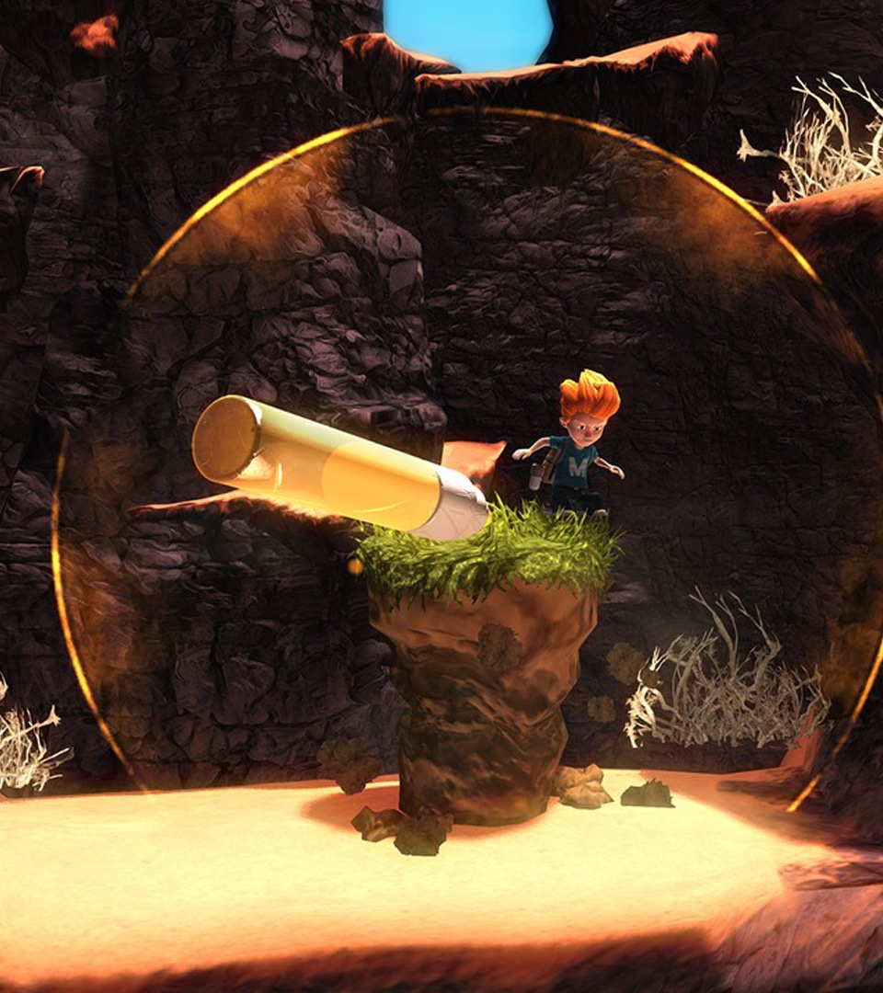
Max: Curse of Brotherhood
by Press Play
Xbox 360, Xbox One
2.5D puzzle platformer
Unity benefits:
  Access to Unity source code
  and engineers
  Visual, performance quality
Notes:
Unity enabled relatively small team to create console title
Link to case story: http://unity3d.com/showcase/case-stories/max-the-curse-of-brotherhood

Slide 49
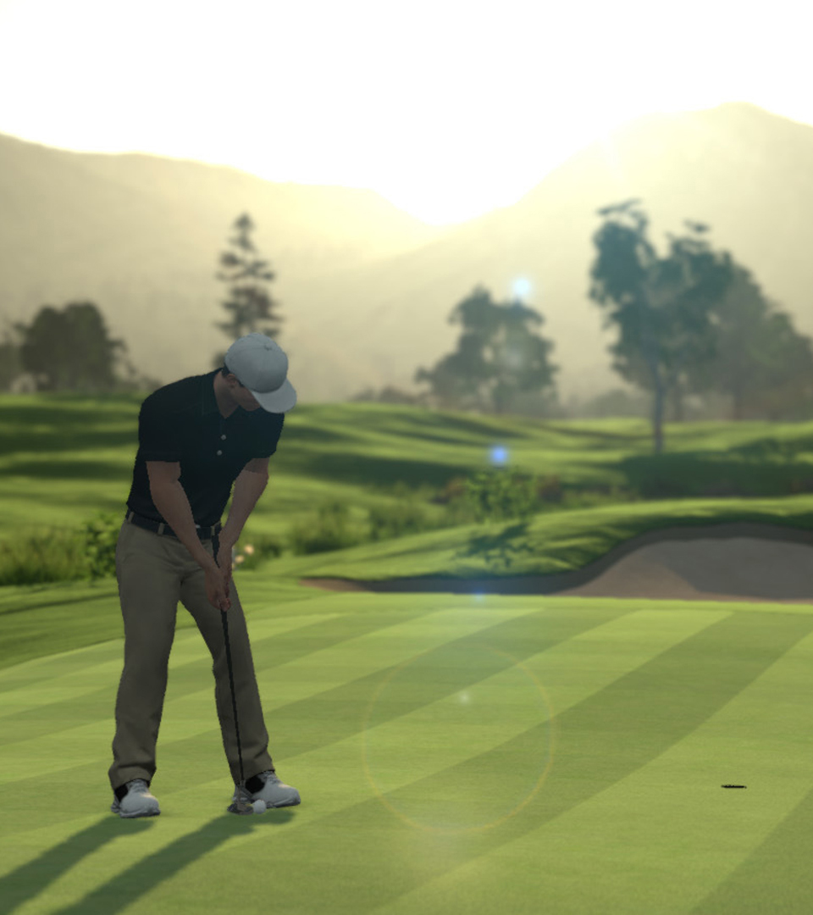
The Golf Club
by HB Studios
PS4, PS Vita, PC
A next-gen golf simulator with procedural course generation
Create courses, share with friends, compete online
Unity benefits:
  Visual quality
  Advanced physics
  Multiplatform, multiplayer support
Notes:
Whole new style of golf game play
Create new procedurally generated course with just a few clicks
Create custom golf course
Gorgeous visuals

Slide 50
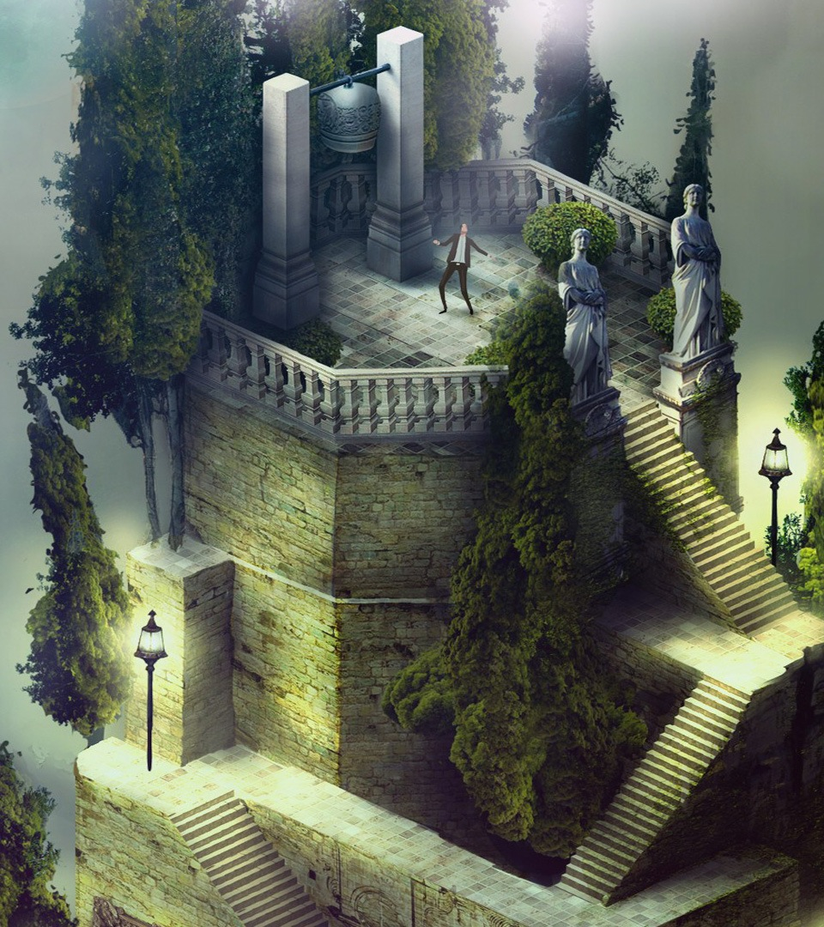
Pavilion
by Visiontrick
PS4, PS Vita
Puzzling adventure
Unity benefits:
  Flexibility
  Visual Editor, scripting
  Rapid production
Notes:
Editor flexibility was crucial to speed
Prototype in 2 weeks
Unity supported small team to make visually rich game

Slide 51

Call of Duty:
Strike Team
by The Blast Furnace
and Activision
iOS, Android
Shooter, strategy
Unity benefits:
  Mobile support
  Visual quality
  Cost-effective
Notes:
Another great example of a AAA console IP brought to mobile with Unity.

Slide 52
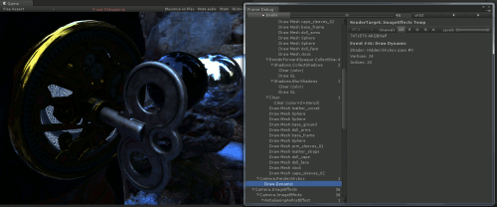
Frame Debugger
Notes:
My favorite feature in Unity 5, Frame Debugger,
Blog post: http://blogs.unity3d.com/2014/07/29/frame-debugger-in-unity-5-0/

Slide 53
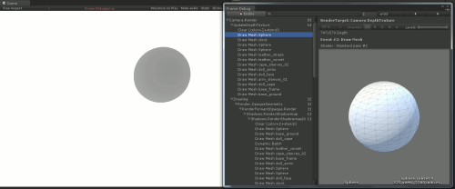
Frame Debugger
Notes:
My favorite feature in Unity 5, Frame Debugger,
Blog post: http://blogs.unity3d.com/2014/07/29/frame-debugger-in-unity-5-0/

